Slide 1

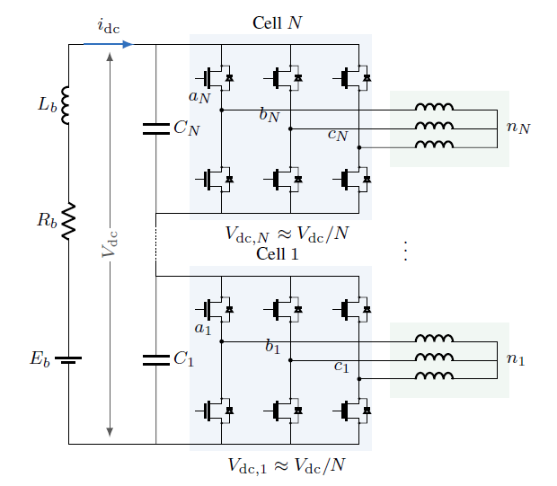
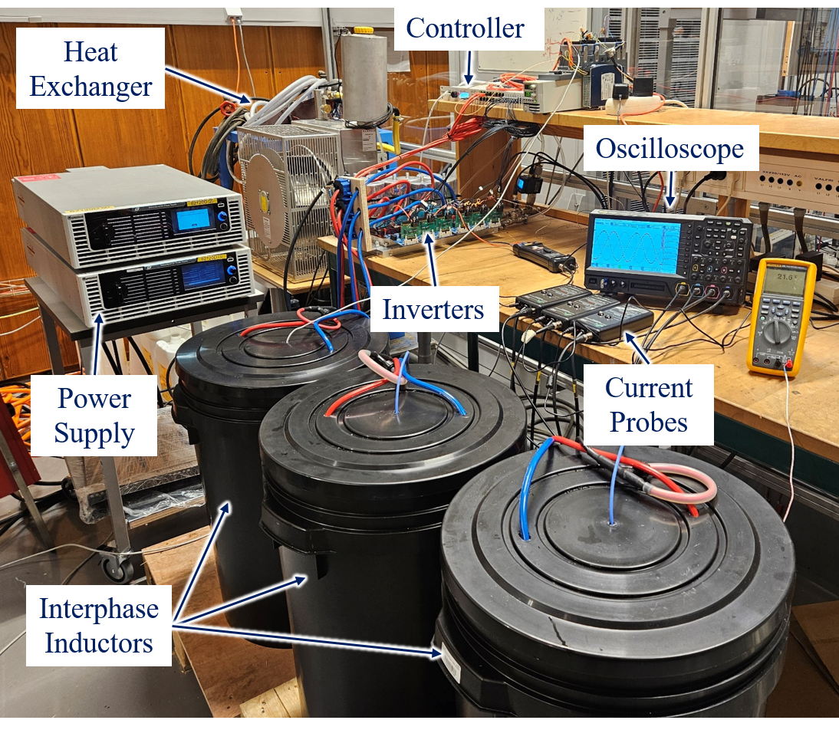
Enes Ayaz
PhD topic: High-Voltage Traction Inverters
THE PROJECT
Background Higher DC-link voltages offer opportunities to improve traction-drive performance and enable high-power charging for electric vehicles.
Challenge Increasing voltage introduces tradeoffs across charging, inverter power density and efficiency, common-mode stress, and motor harmonic losses.
Goal Compare and evaluate two-level, multilevel, and stacked polyphase bridge inverter topologies, and jointly optimize the inverter and motor for overall traction-drive performance.
Supervisors: Staffan Norrga, Hans-Peter Nee
Period: 2023 – 2028
Funding: Hemizero (Vinnova), Powerized (EU), Moore4Power (EU)
Partners: Scania, Inmotion, Infineon, and etc.
DONE SO FAR
Reviewed inverter topologies for high-voltage traction drives.
Compared two-level and three-level inverters with SiC MOSFETs.
Jointly optimized a two-level inverter and motor regarding harmonic losses.
Built an 2-level inverter prototype and experimentally validated the design.
ONGOING → NEXT
Now: Low-voltage GaN building-block design for stacked polyphase bridge inverters.
Next: Integrated motor–inverter optimization and experimental validation.
2-Level High-Voltage VSI Prototype
Stacked Poly-Phase Inverter
PUBLICATIONS
E. Ayaz et al., “DC-Link Voltage Scaling to 1.2 kV for Heavy-Duty EVs: System-Level Assessment with Experimental Validation of SiC Traction Inverter,” IEEE Access, 2026.
E. Ayaz et al., “Real-Time DC-Link Capacitor Stress Reduction in Two-Level Three-Phase Inverters Using Adaptive Multi-Carrier PWM Method,” IPEC–ECCE Asia, 2026.
E. Ayaz et al., “Primary-Side Control of Bipolar Field Excitation System for Pole-Changing Electrically Excited Synchronous Machines,” IEEE Transactions on Industrial Electronics, 2026.
E. Ayaz et al., “Common-Mode Voltage Reduction in Two-Level Inverters by Introducing Adaptive Carrier-Phase-Shift Method,” ECCE Europe, 2025.
E. Ayaz et al., “Evaluation of Possible Traction Inverter Topologies for Heavy-Duty Electric Vehicles,” SPEC, 2024.
METHODS & TOOLS
FEM simulation
PCB Design
MATLAB
Python
AI

